Slide 1
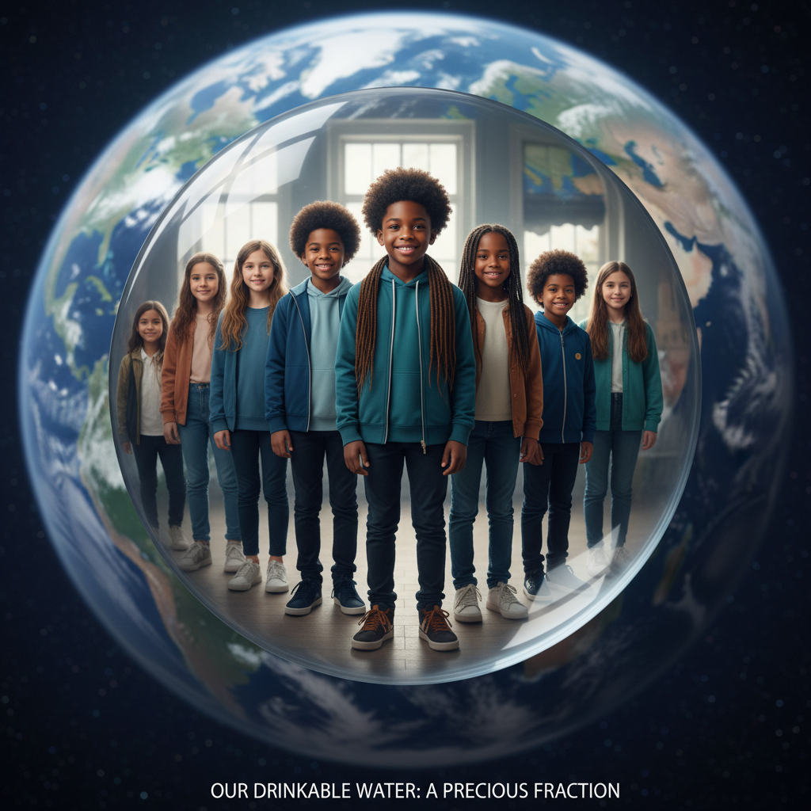
ModelIt!
Student Lesson
Earth's Hidden Water
97% Is Undrinkable, 2% Is Frozen. We Live on the Rest.
NGSS: 5-ESS2-2
5th Grade
1/9

Slide 2
What You Will Learn Today
Learning Goals
* Describe the distribution of Earth's water across major reservoirs
* Model how precipitation and temperature control freshwater availability
* Explain how evaporation reduces accessible water
* Predict how climate patterns affect freshwater supplies
Key Vocabulary
Precipitation
Any form of water falling from clouds (rain, snow, hail)
Evaporation
Water turning into vapor and rising into the atmosphere
Freshwater
Water that is safe to drink and use
Reservoir
A natural or artificial storage place for water
2/9

Slide 3

The Big Question
What controls how much fresh water is available for communities to use?
97% Is Undrinkable, 2% Is Frozen. We Live on the Rest.. Today we'll build a MODEL to discover the answer!
3/9

Slide 4

Today We Will Build a Model!
A model helps us understand complex systems!
1. LOCATE
Identify the COMPONENTS (parts) of the system
2. ESTABLISH
Connect them with RELATIONSHIPS (+ or -)
3. VISUALIZE
Build your model in ModelIt!
4. EVALUATE
Run SIMULATIONS to test scenarios
5. REVISE
Improve your model based on evidence
4/9

Slide 5

Activity 1: Sort the Components
Sort these components into EXTERNAL (inputs from outside) and INTERNAL (inside the system):
Your Components:
* Precipitation Amount
* Temperature
* Freshwater Availability
* Evaporation Rate
Think: Which components can we control? Which happen on their own?
5/9

Slide 6
Activity 2: Connect with Arrows
Draw arrows to show HOW components affect each other:
(+) POSITIVE Relationship
When one goes UP, the other goes UP too
(-) NEGATIVE Relationship
When one goes UP, the other goes DOWN
Think About It:
When temperature rises, what happens to water in lakes and rivers?
6/9

Slide 7
Activity 3: Run the Simulation!
Test these scenarios in ModelIt!
Normal Conditions
Set both Precipitation and Temperature to moderate levels
Drought + Heat Wave
Lock Precipitation to 10% and Temperature to 90%
Winter Snowpack
Lock Temperature to 20% and Precipitation to 80%
Watch the activity graphs change!
[ModelIt Platform Screenshot - Simulation Results Graph]
7/9

Slide 8
What Did We Discover?
Our Model Showed Us:
* Less than 1% of Earth's water is accessible fresh water
* Precipitation ADDS to freshwater availability
* Evaporation REMOVES from freshwater availability
* Hot, dry conditions create water crises for communities
Answer: The balance between precipitation adding water and evaporation removing it determines how much fresh water is available!
8/9

Slide 9

STEM Challenge: Design a Water Conservation Plan
YOUR ENGINEERING MISSION
Design a water conservation plan for a city facing drought conditions.
The Challenge:
A city is running low on water. They need to reduce usage by 40% without hurting residents.
Think Like an Engineer:
* Which uses of water are essential vs. optional?
* How can you reduce evaporation from reservoirs?
* What technologies can recycle or reuse water?
REAL CAREER CONNECTION: Hydrologists and Water Resource Managers protect community water supplies and predict droughts. They earn $75,000-$110,000/year. The skills you're using TODAY are the same ones they use on the job!
9/9

